Slide 1
Lab 2: Introduction to hardware description language

Slide 2
Design flow
In this course: To design a digital circuit
Describe hardware using HDL (SystemVerilog)
Simulate
(ModelSim)
Synthesis
(Quartus)
Truth table
Test on board
(STEP MAX 10) board

Slide 3
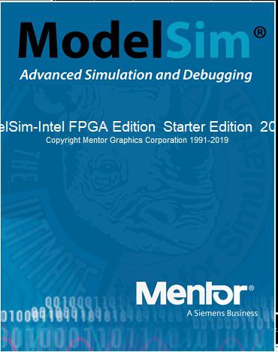
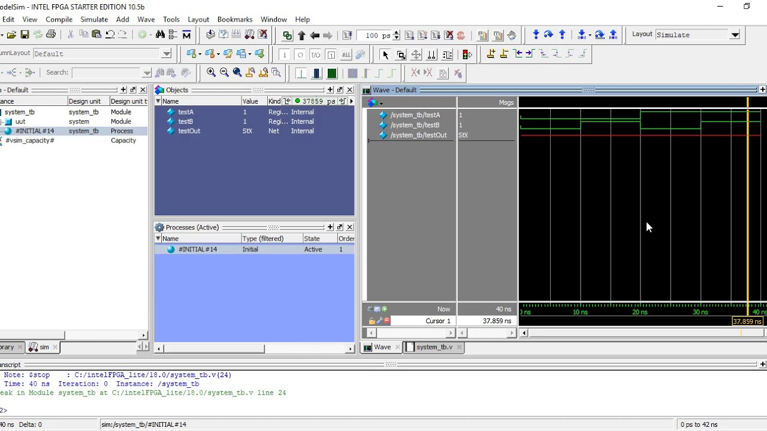

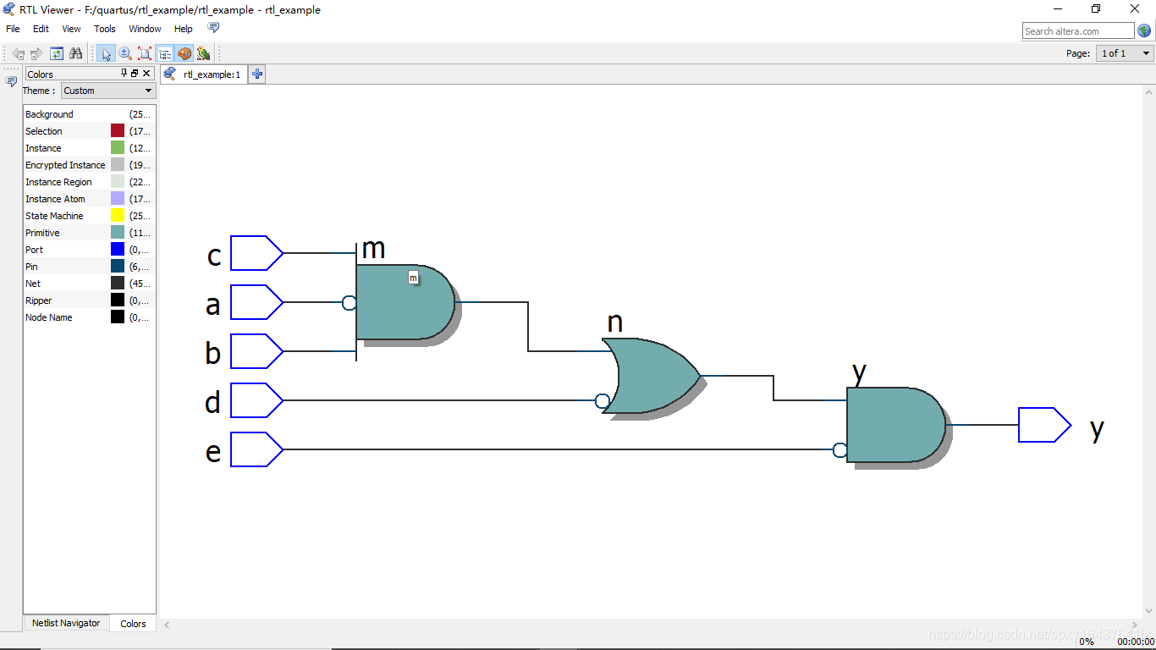
Simulation and Synthesis
Simulation
To verify the module operates correctly or not
By applying inputs to a module and checking outputs
Synthesis
Textual description of a module is transformed into logic gates.

Slide 4
Hardware description language
Hardware Description Languages (HDL) like SystemVerilog are used to describe hardware
behavior
-> It can be converted to digital blocks made up of combinational and sequential elements.
SystemVerilog is an extension of Verilog with more features

Slide 5
Module
Definition:
Module is block of SystemVerilog code that implements a certain functionality
A module can be embedded within other modules and these modules can communicate
with each other using their input + output ports.
Syntax:
module Module_name( input [data_type] port1, input [data_type] port2, output [data_type] port3);
//internal logic
endmodule
Declaration: Using module keyword, followed by module name, an optional port list; end of a module by
endmodule keyword
Portlist: Specify input, output ports to module and their data types; portlist is optional.
Internal logic: Specify how module ’s outputs are derived from its inputs: using operators, assignments, variables, statements, call other modules,…..

Slide 6
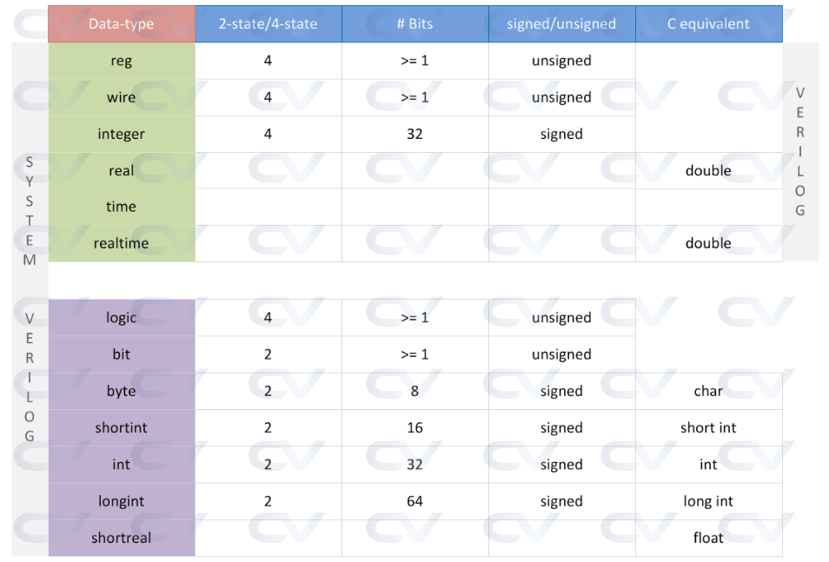
Data types and values of a variable
Basic data types available in SystemVerilog are shown in table below:
Nearly all SystemVerilog signals can be logic, except that
signals with multiple drivers
Values SystemVerilog variables can hold
0 | represents a logic zero, or a false condition
1 | represents a logic one, or a true condition
x or X | represents an unknown logic value (can be zero or one)
z | represents a high-impedance state

Slide 7
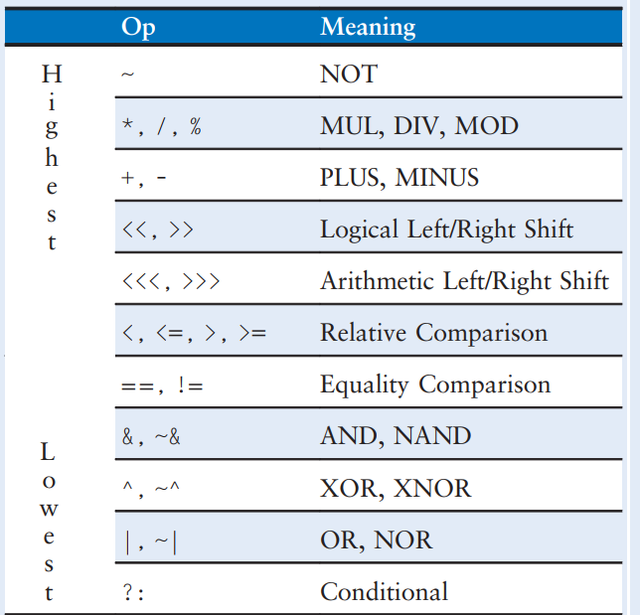
Operator and precedence
SystemVerilog operators and precedence of operators are shown in below table:
Some types of operators:
- Arithmetic operators
- Relational operators
- Bitwise operators
- Conditional operator
- Assignment operators
+ Blocking assignment
+ Non-blocking assignment

Slide 8
Continuous and conditional assignment assignamn
Continuous assignment: value of the left-hand side signal is continuously updated to match the value of the right-hand side expression
assign statement is used to create continuous assignment in hardware description.
Syntax:
assign LHS = RHS
LHS: signal need to assign a value to
RHS: signal or expression
Conditional assignment: select the output from among alternatives based on an input called the condition
Using assign statement and conditional operator ?:
Syntax:
assign y= <first exp> ?: <second exp> : <third exp>
Based on value of first exp (condition) to choose second exp or third exp

Slide 9
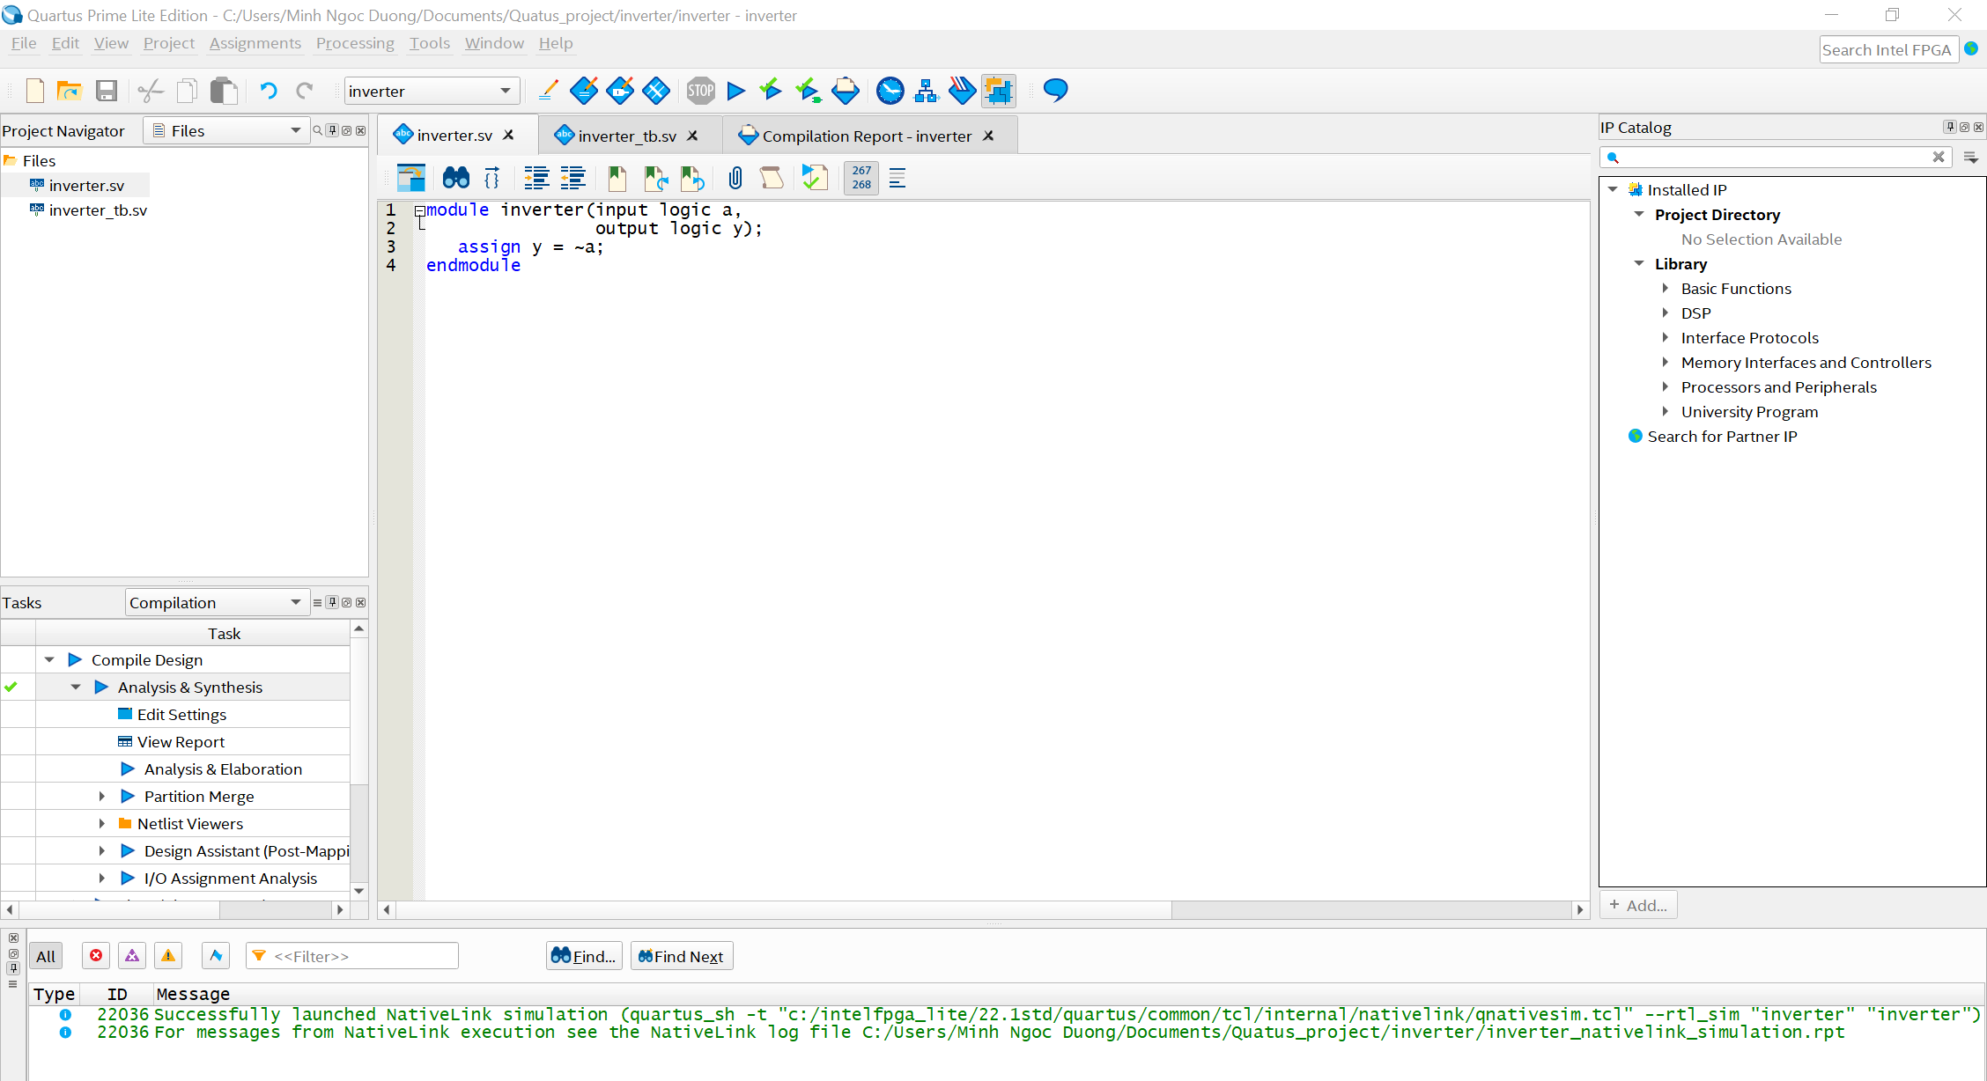
Example: inverter
An example of design an inverter using SystemVerilog is shown below
module inverter(input logic x,
output logic y);
assign y = ~x;
endmodule

Slide 10
Writing testbench
Testbench: a SystemVerilog module to verify the functionality of a design through simulations.
Steps:
- Top level hardware design module is instantiated within testbench
- Declare testbench component signals and connect them to design ‘s input/output ports
- Inputs to the design are driven with certain values
- Outputs of design are analyzed and compared with expected values to check if the design behavior is correct or not

Slide 11
Writing testbench (cont)
Structure of a testbench:
// All verification components are placed in this top testbench module
Module tb_top();
// Declare testbench component signals that need to be connected to the design instance
// These signals are assigned some values that in turn gets transferred to
// the design as inputs because they are connected with the ports in the design
logic a, b, y;
// Instantiate the design module and connect the testbench component signals declared above with the ports in the design
mydesign DUT(a,b,y);
//Assign values to testbench component signals that can be diven to the design
DUT stands for design under test and is top hardware design module written in SystemVerilog

Slide 12
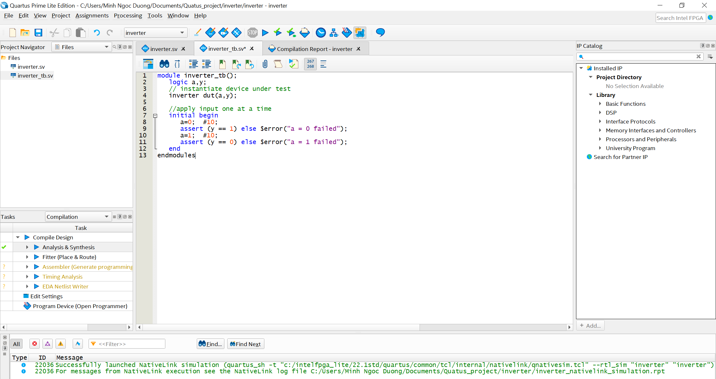
Example: inverter (cont)
An example testbench for inverter design is given below:
module inverter_tb();
logic a,b;
// instantiate device under test
inverter dut(a,b);
//apply input one at a time
initial begin
a=0; #10;
assert (b == 1) else $error(“a = 0 failed”);
a=1; #10;
assert (b == 0) else $error(“a = 1 failed”);
end
endmodule
delay:#10 – delay 10 time units
initial: define a block of code that is
execute once at the beginning of a simulation;
used for initialization, testbench setup,…
assert: a statement is used to specified and check conditions during design and verification.
$error: is used to report error message during simulation, if encounterd, $error stops simulation and displays message.

Slide 13
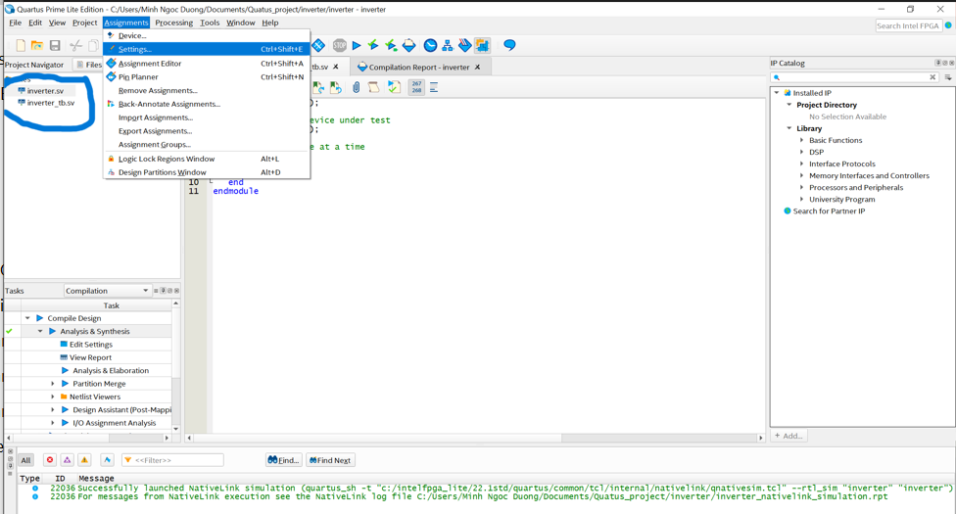
Run simulation in Quaturs
After add inverter.sv and inverter_tb.sv file to current project -> run simulation
Choose Asignments -> Settings to add testbench file

Slide 14
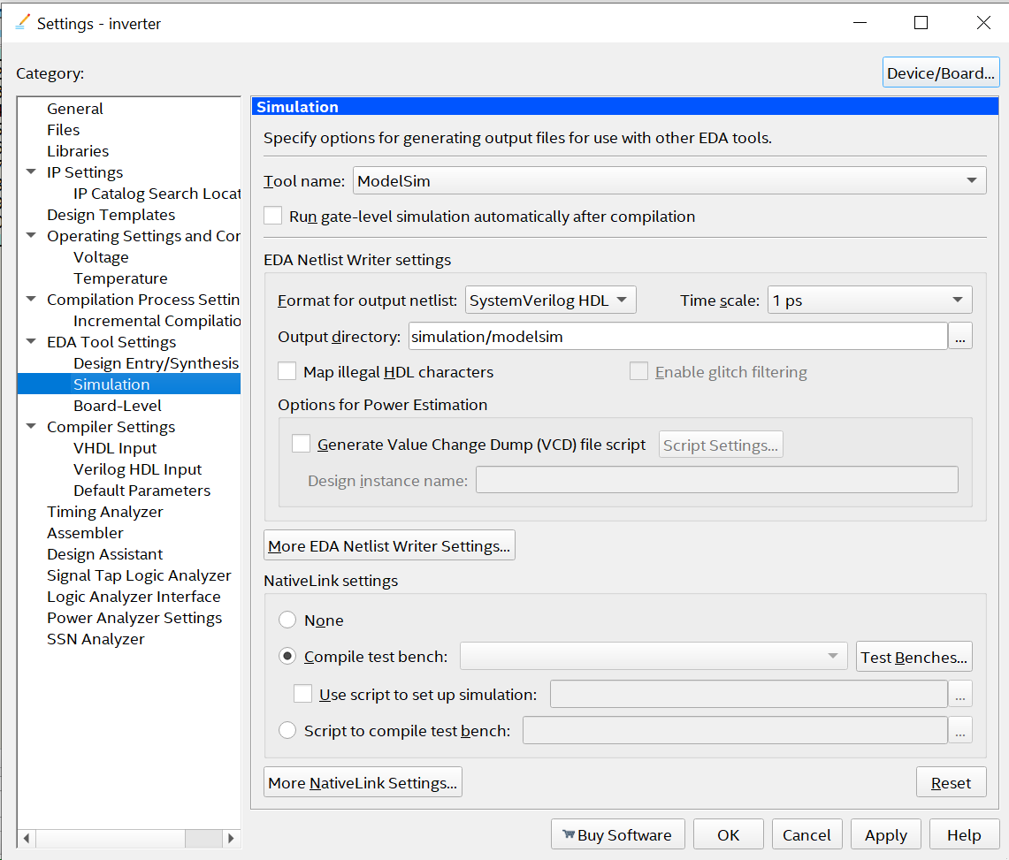
Run simulation in Quaturs (cont)
In Settings, go to Simulation and configure as picture below

Slide 15
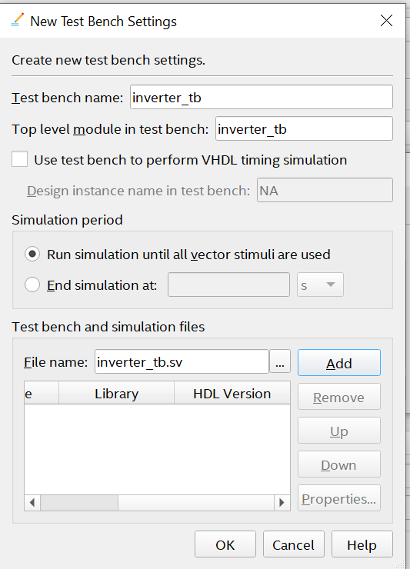
Run simulation in Quaturs (cont)
Click on TestBenches -> New
Enter test bench name, top level module in test bench
In Filename, browse to inverter_tb.sv file in your computer and click Add -> OK

Slide 16
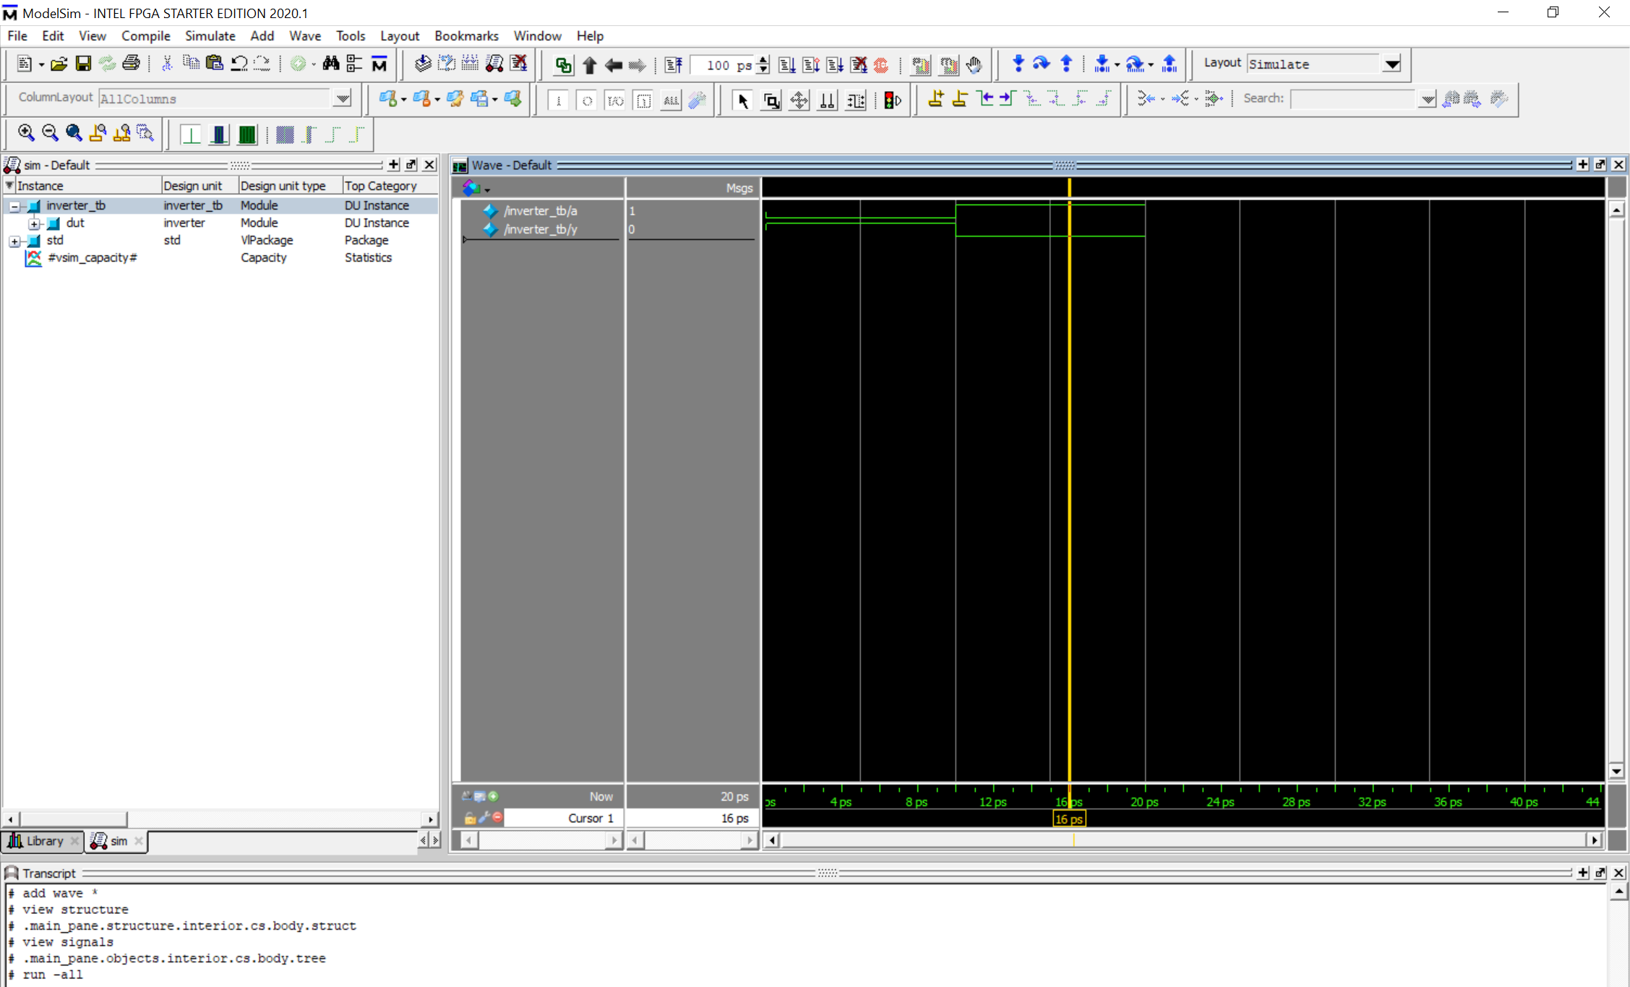
Run simulation in Quaturs (cont)
Add path to ModelSim: go to Tools -> Options -> EDA Tool Options -> add path to ModelSim Altera
Path has format:
C:/intelFPGA_lite/20.1std/modelsim_ase/win32aloem
Choose Tools -> Run Simulation Tool -> RTL Simulation to lauch ModelSim and observe result of simulation

Slide 17
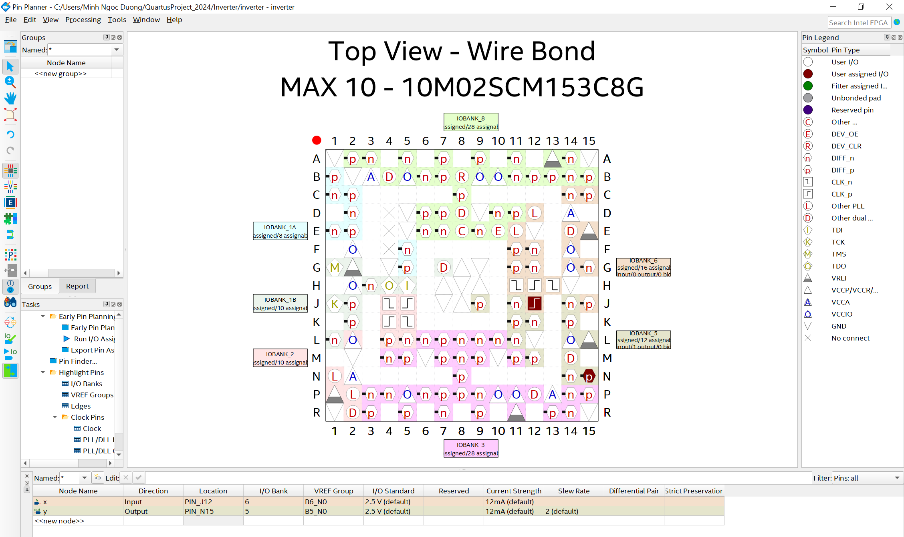
Test design module in STEP MAX-10 board (cont)
Go to Assignments -> Pin Planner -> assign pins of design module on DE-10 board

Slide 18
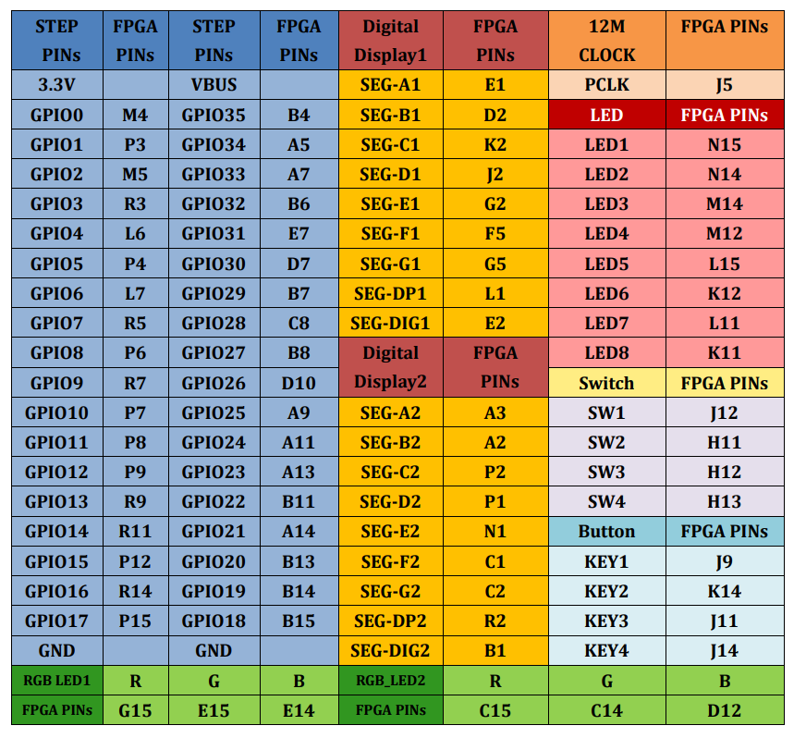
Test design module in STEP MAX-10 board (cont)
Below table show Pin assignment on STEP MAX-10 board

Slide 19
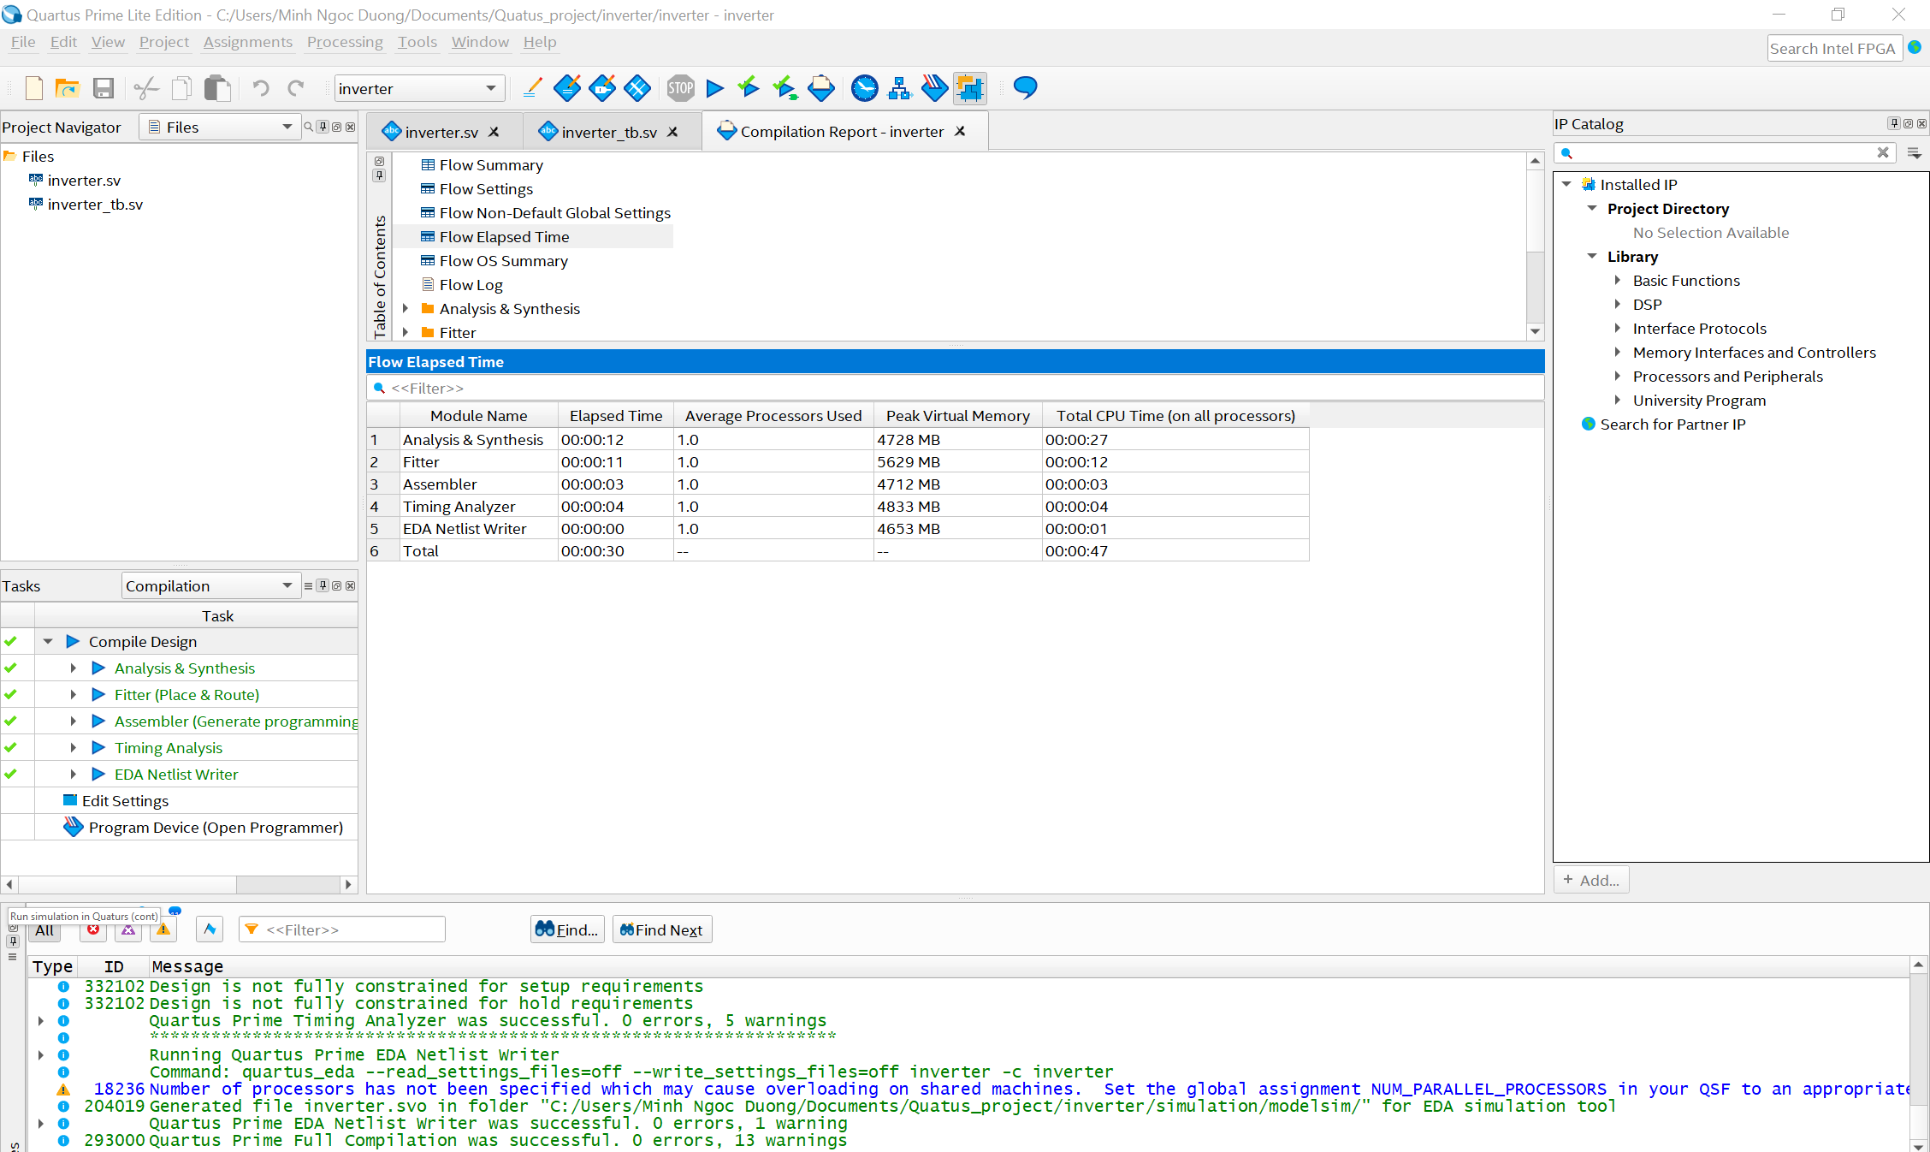
Test design module in STEP MAX-10 board (cont)
Do complete Compline step in design
Right click on Compile Design -> Start
All green check mark -> done Compline

Slide 20
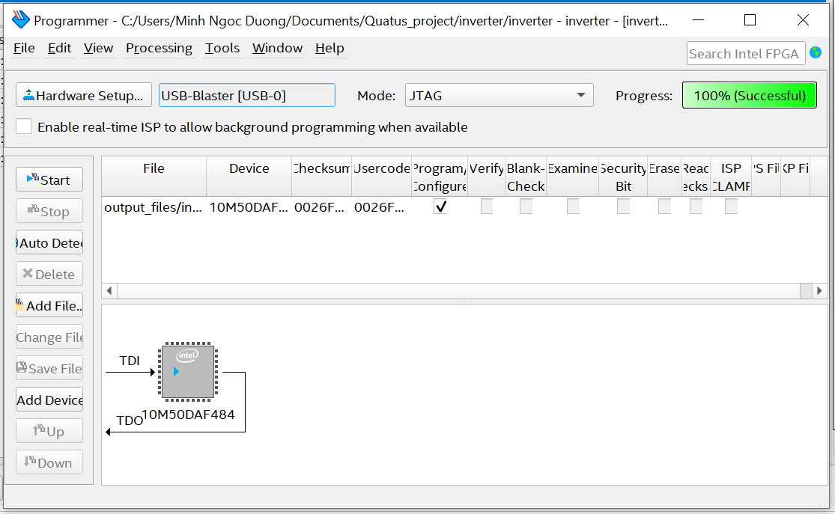
Test design module in STEP MAX-10 board (cont)
Go to Tool -> Programmer
After select Hardware , click on Start
Progress bar is full with green -> Done
Check operations of design on DE-10 board

Slide 21
Exercises
Ex1: Design a NAND gate using SystemVerilog, simulate on ModelSim and test operations of design in STEP MAX-10 board.
Ex2: Design a 2:1 multiplexer using SystemVerilog, simulate on ModelSim and test operations of design in STEP MAX-10 board. (Using conditional operator)
Ex3: Design a 4:1 multiplexer using SystemVerilog, simulate on ModelSim and test operations of design in STEP MAX-10 board. (Using conditional operator)

